Slide 1
CS4038
DATA MINING
LECTURE # 20
SPRING 2024
FAST – NUCES, CFD CAMPUS
AYESHA LIAQAT
ayesha.liaqat@nu.edu.pk

Slide 2
TODAY’S TOPICS
K-means clustering

Slide 3
PARTITIONAL CLUSTERING
K-MEANS ALGORITHM

Slide 4
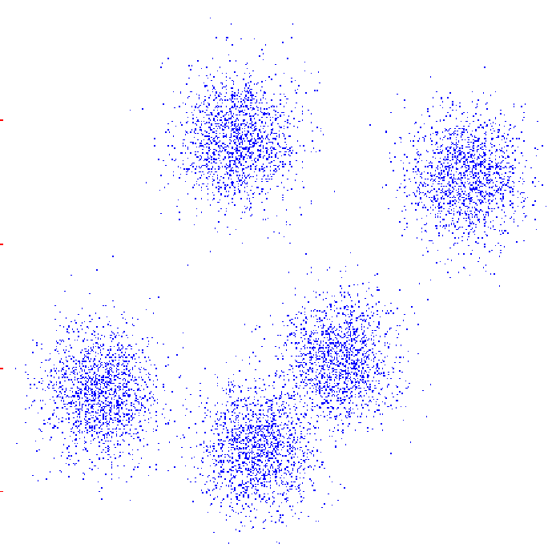
K-MEANS
An iterative clustering algorithm
Initialize: Pick K random points as cluster centers (means)
Alternate:
Assign data instances to closest mean
Recompute the mean for each cluster based on its data points
Stop when no points’ assignments change

Slide 5
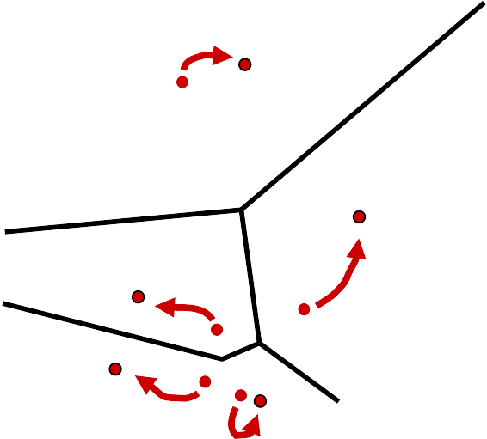
K-MEANS
To be specified by the user at the begining
An iterative clustering algorithm
Initialize: Pick K random points as cluster centers (means)
Alternate:
Assign data instances to closest mean
Recompute the mean for each cluster based on its data points
Stop when no points’ assignments change

Slide 6
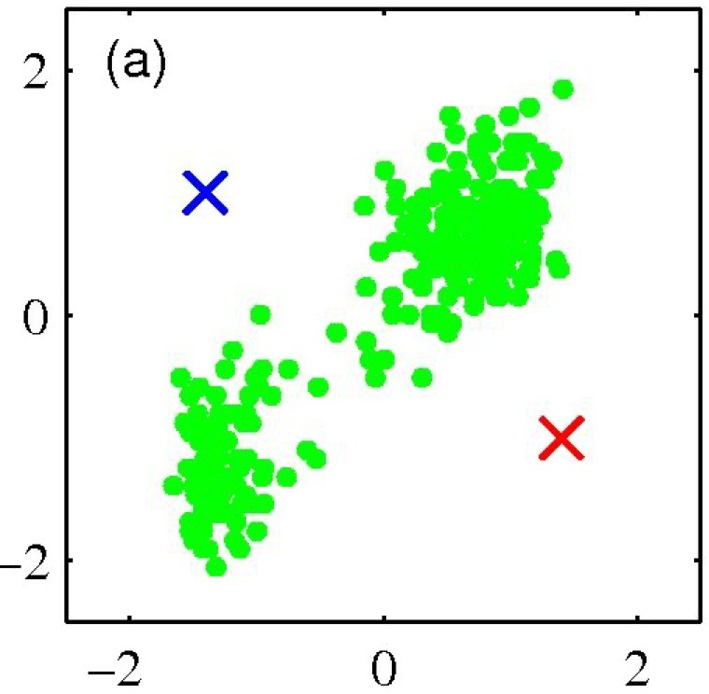
K-MEANS CLUSTERING: EXAMPLE
Pick K random points as cluster centers (means)
Shown here for K=2

Slide 7
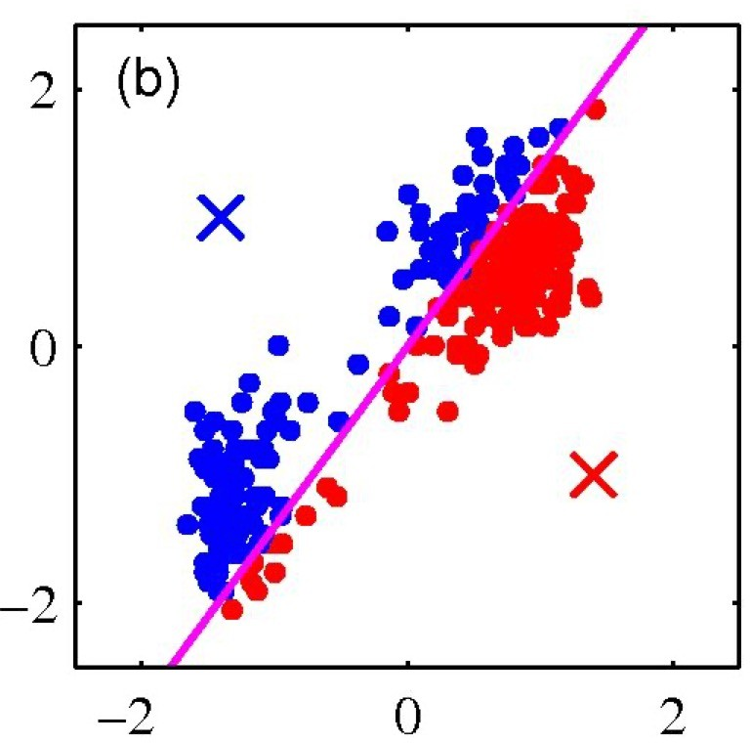
K-MEANS CLUSTERING: EXAMPLE
Iterative Step 1
Assign data points to closest cluster center

Slide 8
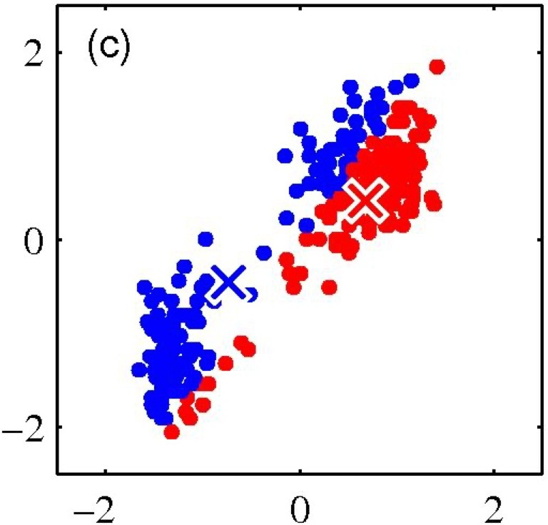
K-MEANS CLUSTERING: EXAMPLE
Iterative Step 2
Change the cluster center to the average of assigned points

Slide 9
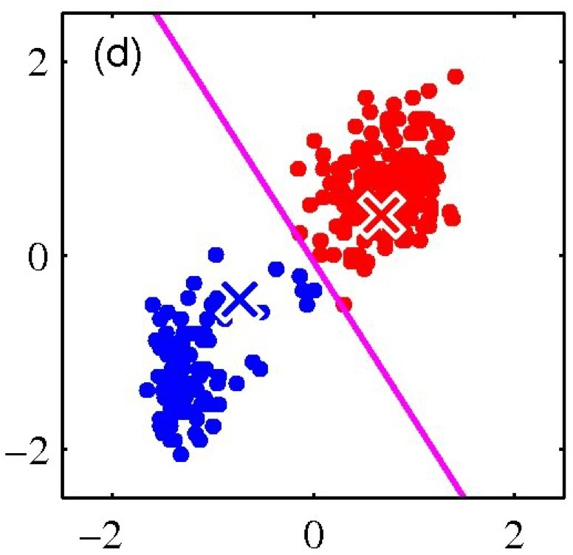
K-MEANS CLUSTERING: EXAMPLE
Repeat until convergence

Slide 10
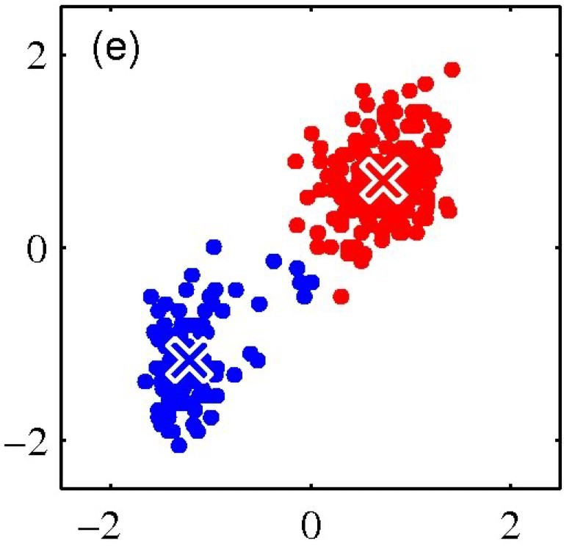
K-MEANS CLUSTERING: EXAMPLE
Repeat until convergence

Slide 11
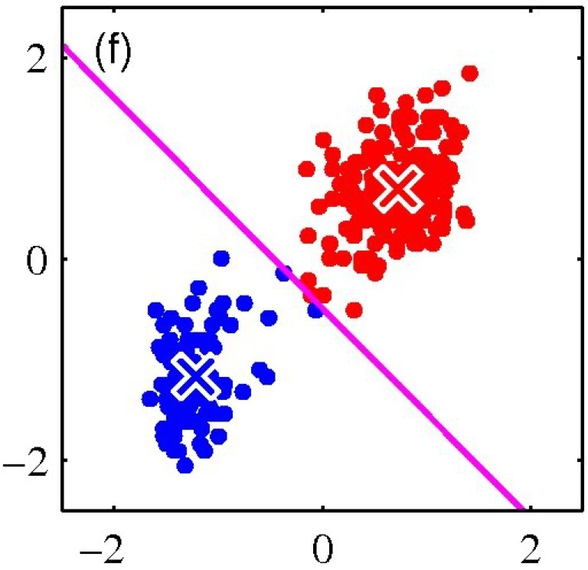
K-MEANS CLUSTERING: EXAMPLE
Repeat until convergence

Slide 12
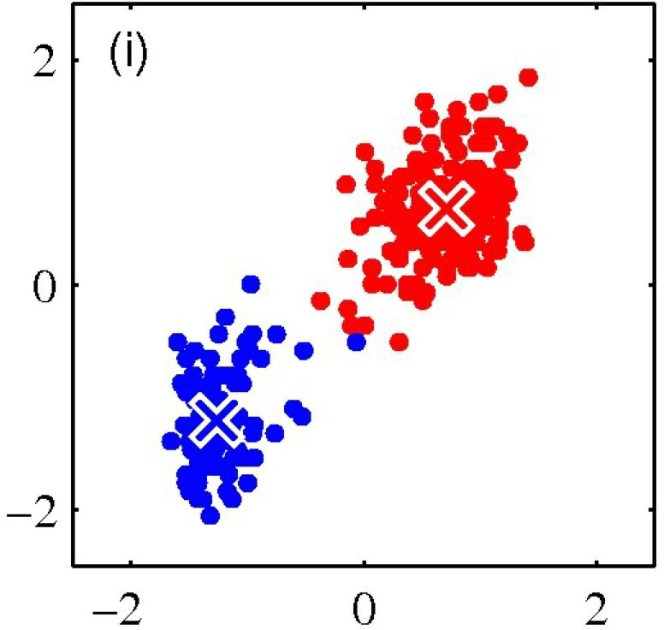
K-MEANS CLUSTERING: EXAMPLE
Repeat until convergence

Slide 13
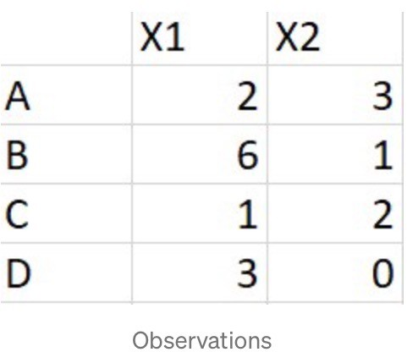
EXAMPLE
Consider 4 data points:
Let’s assume our two centroids are:
C1: (4,2)
C2: (2,1)
(average of AB) (average of CD)
Now follow K-means steps and find final groups of data points

Slide 14
PROPERTIES OF K-MEANS ALGORITHM
Guaranteed to converge in a finite number of iterations
Running time per iteration:
1. Assign data points to closest cluster center
O(KN)
2. Change the cluster center to the average of its assigned points
O(N)

Slide 15
K-MEANS CLUSTERING
Strengths
Simple iterative method
User provides “K”
Weaknesses
Often too simple → bad results
Difficult to guess the correct “K”

Slide 16
WHAT PROPERTIES A DISTANCE MEASURE SHOULD HAVE?
Symmetric
d(x,y) = d(y,x)
Otherwise, we can say x looks like y but y doesn’t look like x
Positivity, and self-similarity
d(x,y) >= 0 d(x,y)=0 iff x=y
Otherwise, there will be different objects that we cannot tell apart
Triangle inequality
d(x,y) + d(y,z) >= d(x,z)
Otherwise, one can say “x is like y, y is like z, but x is not like z at all”

Slide 17
K-MEANS ISSUES
Distance measure is squared Euclidean
Scale should be similar in all dimensions
Rescale data?
Not good for nominal data.Why?
Approach tries to minimize the within-cluster sum of squares error (WCSS)
WCSS is the sum of squared distance between each point and the centroid in a cluster.
Implicit assumption that SSE is similar for each group
Notes:
Euclidean distance, no natural ordering so artificial distances
Distance b/w categories not well defined so assumption of clusters to be compact,isotropic does not old true

Slide 18

WCSS
WCSS is the sum of squared distance between each point and the centroid in a cluster.
The over all WCSS is given by:
The goal is to find the smallest WCSS
Does this depend on the initial seed values?
Possibly.
Notes:
WCSS measures the sum of squared distances of each data point to its assigned cluster centroid. It quantifies the compactness of the clusters, with lower values indicating tighter, more compact clusters

Slide 19
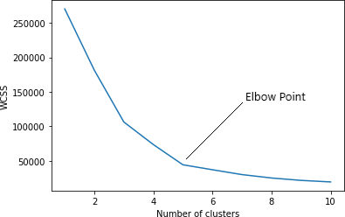
ELBOW METHOD
By varying the value of K, compute within-cluster sum of squared error and pick the optimal K

Slide 20
TRYING TO FIND GOOD OPTIMA
Idea 1: Be careful about where you start
Idea 2: Do many runs of k-means, each from a different random start configuration
Many other ideas floating around.

Slide 21
TRYING TO FIND GOOD OPTIMA
Idea 1: Be careful about where you start
Idea 2: Do many runs of k-means, each from a different random start configuration
Neat trick:
◾
^{Many other} P^{id}la^{e}cªe^{s} fiºrsªt^{ti}c^{n}e^{g}nªt^{r}eºr^{u}o^{n}n^{d.}top of randomly chosen datapoint.
Place second center on datapoint that’s as far away as possible from first center
:
Place j’th center on datapoint that’s as far away as possible
from the closest of Centers 1 through j-1
Copyright © 2001,
2004, Andrew W. Moore
:

Slide 22
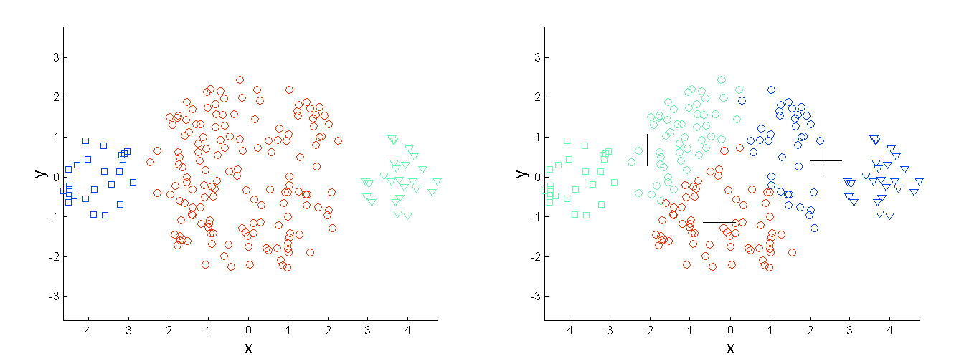
LIMITATIONS OF K-MEANS: DIFFERING SIZES
Original Points
K-means (3 Clusters)
Notes:
K-means assumes that clusters are isotropic and have roughly equal sizes. However, in real-world datasets, clusters may vary significantly in size. When clusters have different sizes, K-means tends to favor larger clusters because it minimizes the within-cluster sum of squares (WCSS). Smaller clusters may get absorbed into larger ones, leading to suboptimal clustering results.

Slide 23
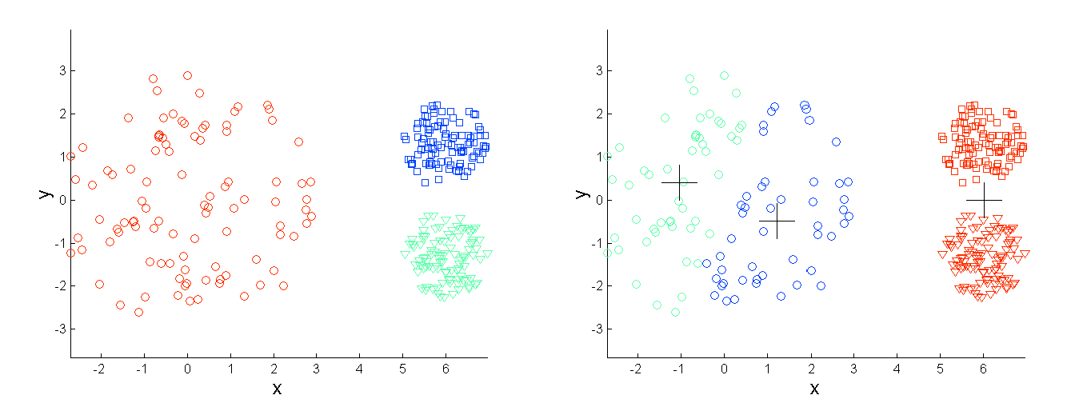
LIMITATIONS OF K-MEANS: DIFFERING DENSITY
Original Points
K-means (3 Clusters)
Notes:
K-means assumes that clusters have roughly uniform densities. In practice, clusters may have varying densities, with some regions having higher concentrations of data points than others. K-means may struggle to identify clusters with varying densities, especially when clusters overlap or when the density gradient within a cluster is non-uniform.

Slide 24
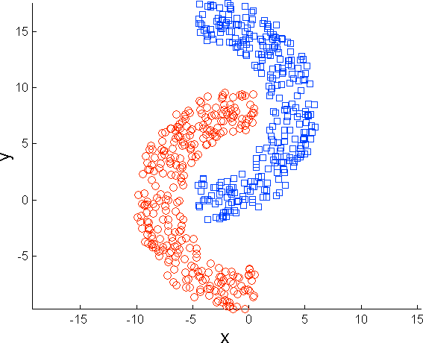
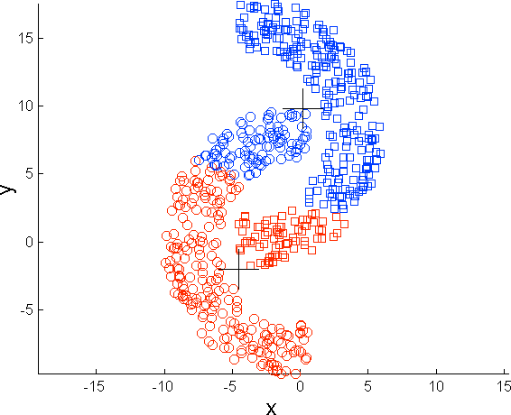
LIMITATIONS OF K-MEANS: NON-GLOBULAR SHAPES
Original Points
K-means (2 Clusters)
Notes:
K-means assumes that clusters are spherical or globular in shape because it minimizes the within-cluster sum of squares based on Euclidean distance. Clusters with non-globular shapes, such as elongated or irregular shapes, may not be accurately represented by spherical centroids. K-means may produce suboptimal results when faced with clusters that exhibit complex shapes or elongated structures.

Slide 25
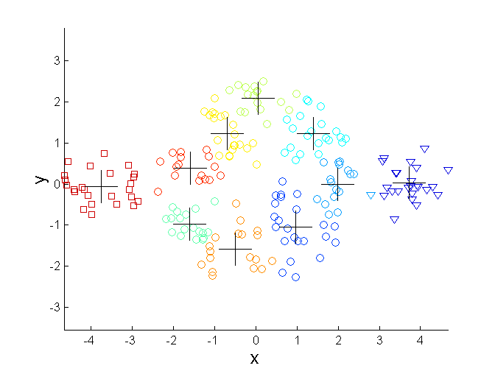
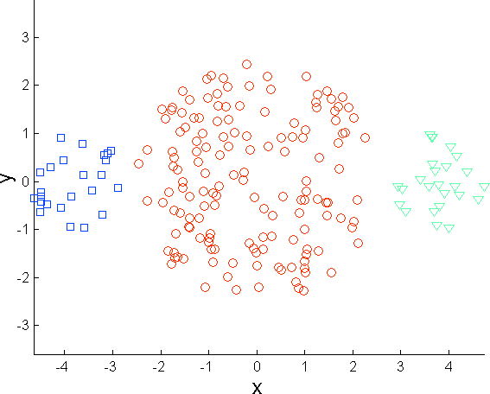
OVERCOMING K-MEANS LIMITATIONS
Original Points K-means Clusters
One solution is to find a large number of clusters such that each of them represents a part of a natural cluster. But these small clusters need to be put together in a post-processing step.

Slide 26
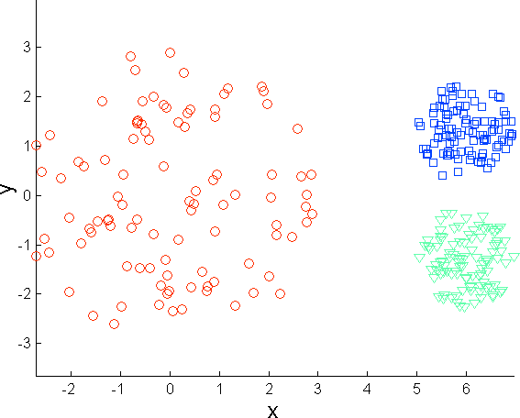
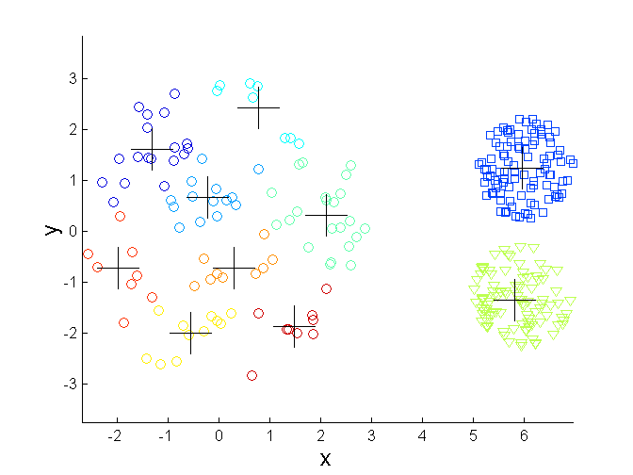
OVERCOMING K-MEANS LIMITATIONS
Original Points K-means Clusters
One solution is to find a large number of clusters such that each of them represents a part of a natural cluster. But these small clusters need to be put together in a post-processing step.

Slide 27
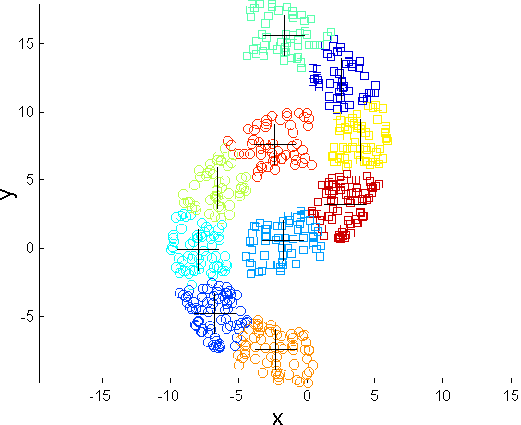
OVERCOMING K-MEANS LIMITATIONS
Original Points K-means Clusters
One solution is to find a large number of clusters such that each of them represents a part of a natural cluster. But these small clusters need to be put together in a post-processing step.

Slide 28
K-MEANS QUESTIONS
Will K-means converge?
To a global optimum?
Will it always find the true patterns in the data?
If the patterns are very very clear?
How many clusters to pick?
A difficult problem
Notes:
It converges to local optima not guarantedly to global optima.Convergence depends upon no.of k, initial centroids, data distr(size,density,shape)
Cannot find very true patterns in data. Due to outliers, sensitivity to initialization

Slide 29
READING MATERIAL
Chapter 2, 8:Tan, Steinbach & Kumar
Chapter 2, 10: Han, Kamber & Pei

